Slide 1
Challenges in using FE for solid mechanics
Liuyang Feng
University of Glasgow
SofTMech training event
28/01/2022

Slide 2
Outline
Implicit v.s. Explicit methods
Mesh generation
Mesh convergence

Slide 3
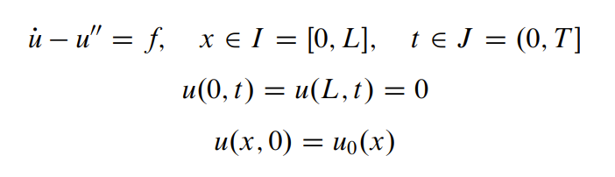
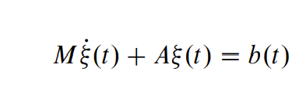
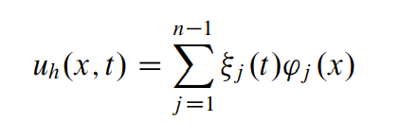
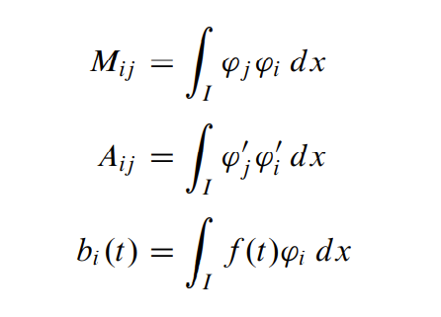
Implicit v.s. Explicit methods
E.g. unsteady heat equation
FE discretization

Slide 4
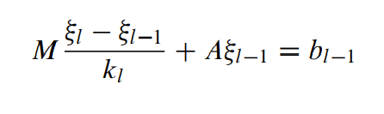
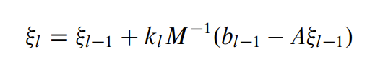
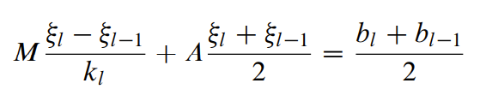
Implicit v.s. Explicit methods
Time discretization, at the Ɩ-th time step with dt = k_{Ɩ}
Explicit method, e.g. forward Euler method
Implicit method, e.g. Crank-Nicolson method

Slide 5
Implicit v.s. Explicit methods
Comparison
 | Implicit methods | Explicit methods
Time step size | Large | Small
Stability | Unconditionally stable | Conditionally stable, requiring small dt to achieve stability
Suitability | Static, Linear or mildly non-linear problems | Dynamic, complex non-linear problems

Slide 6
Implicit v.s. Explicit methods
Solid mechanics simulations
Non-linearity: geometry non-linearity (e.g. large deformation), material non-linearity (e.g. soft tissue), boundary non-linearity (e.g. contact problems).
Static v.s. dynamic processes: For a static problem (e.g. constant loading), if the implicit method doesn’t give a solution, one alternative is to use explicit methods while applying slow loading (quasi-static). It is essential to ensure that the kinetic energy remains low and its ratio to the internal energy shouldn’t exceed 10% typically.
Semi-implicit methods.

Slide 7
General procedures for mesh generation in solid mechanics
Mesh generated from clinical images (MRI and CT scans, etc.)
Step 1, image segmentation
Detect the region of interest for each slice (manual or automatic algorithm to find the boundaries, e.g. Seg3D).
Smoothen boundaries.
Reconstruct 3-D parts (e.g. Parasolid files, SolidWorks, Geomagic).
Step 2, mesh generation
Element selection (type, size, etc.).
Mesh optimization (e.g. different element sizes for different regions, Ansys Workbench, Abaqus).
Mesh generated from existing meshes obtained from open source
Without obtaining geometry files (e.g. TetGen, CGAL):
Surface mesh extraction.
Surface mesh coarsening or refining.
Volume mesh reconstruction.
Obtaining geometry files:
E.g. surface mesh to NURBS surface, Geomagic.

Slide 8
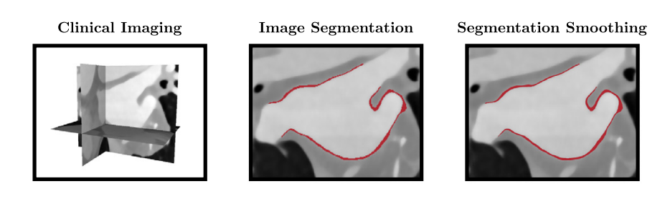
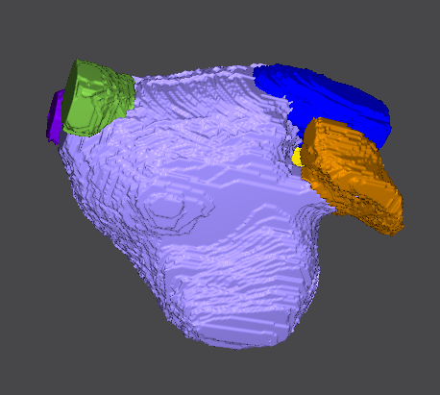
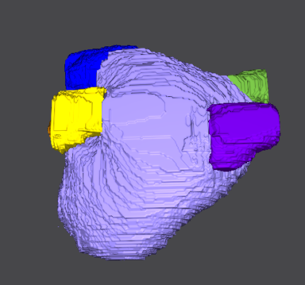
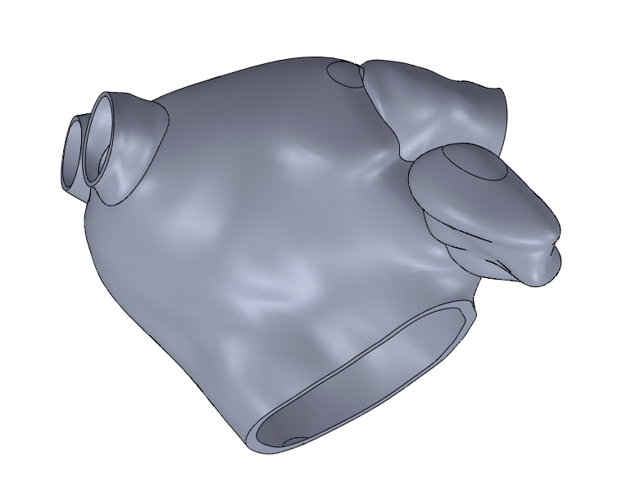
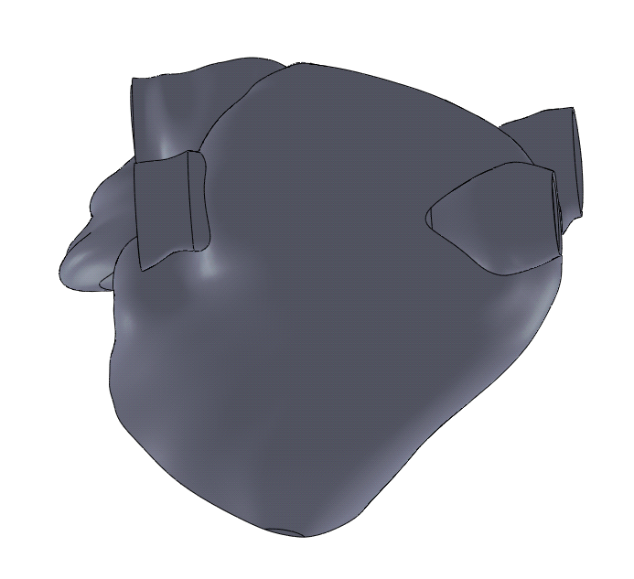
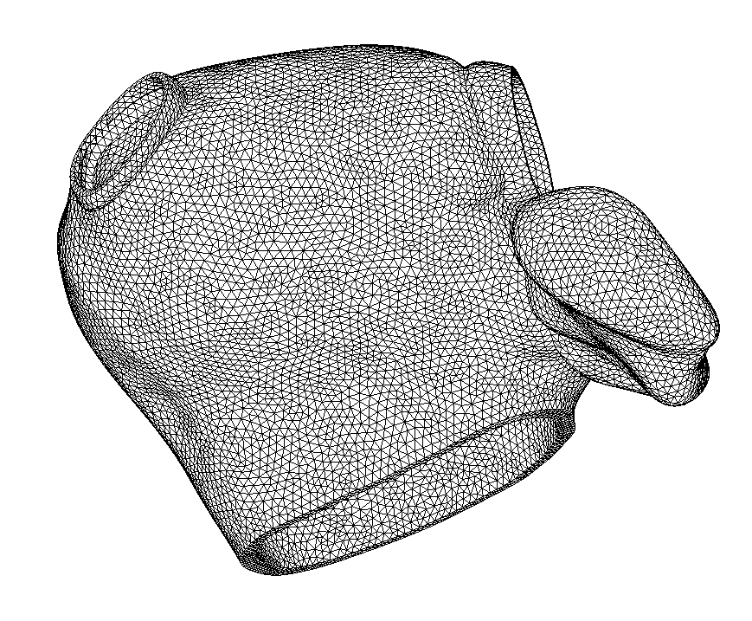
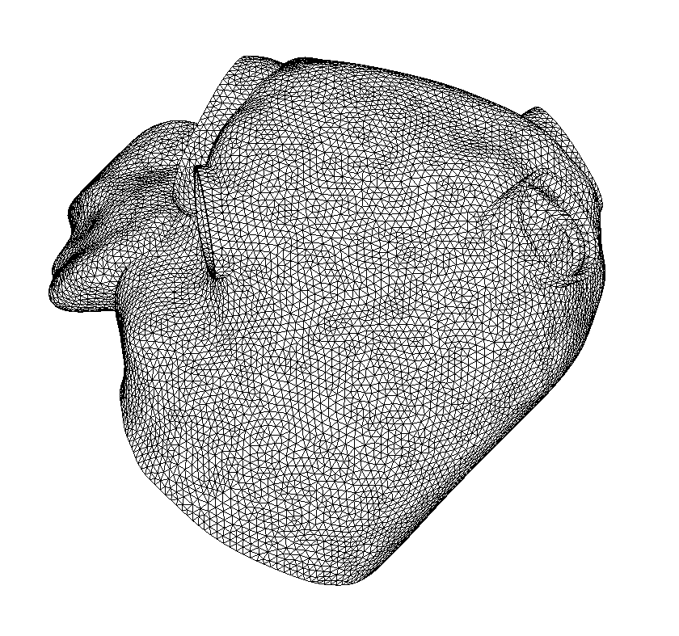
General procedures for mesh generation in solid mechanics
Examples (Left atrium)
Boundary information
Mesh generation
Smoothed geometry

Slide 9
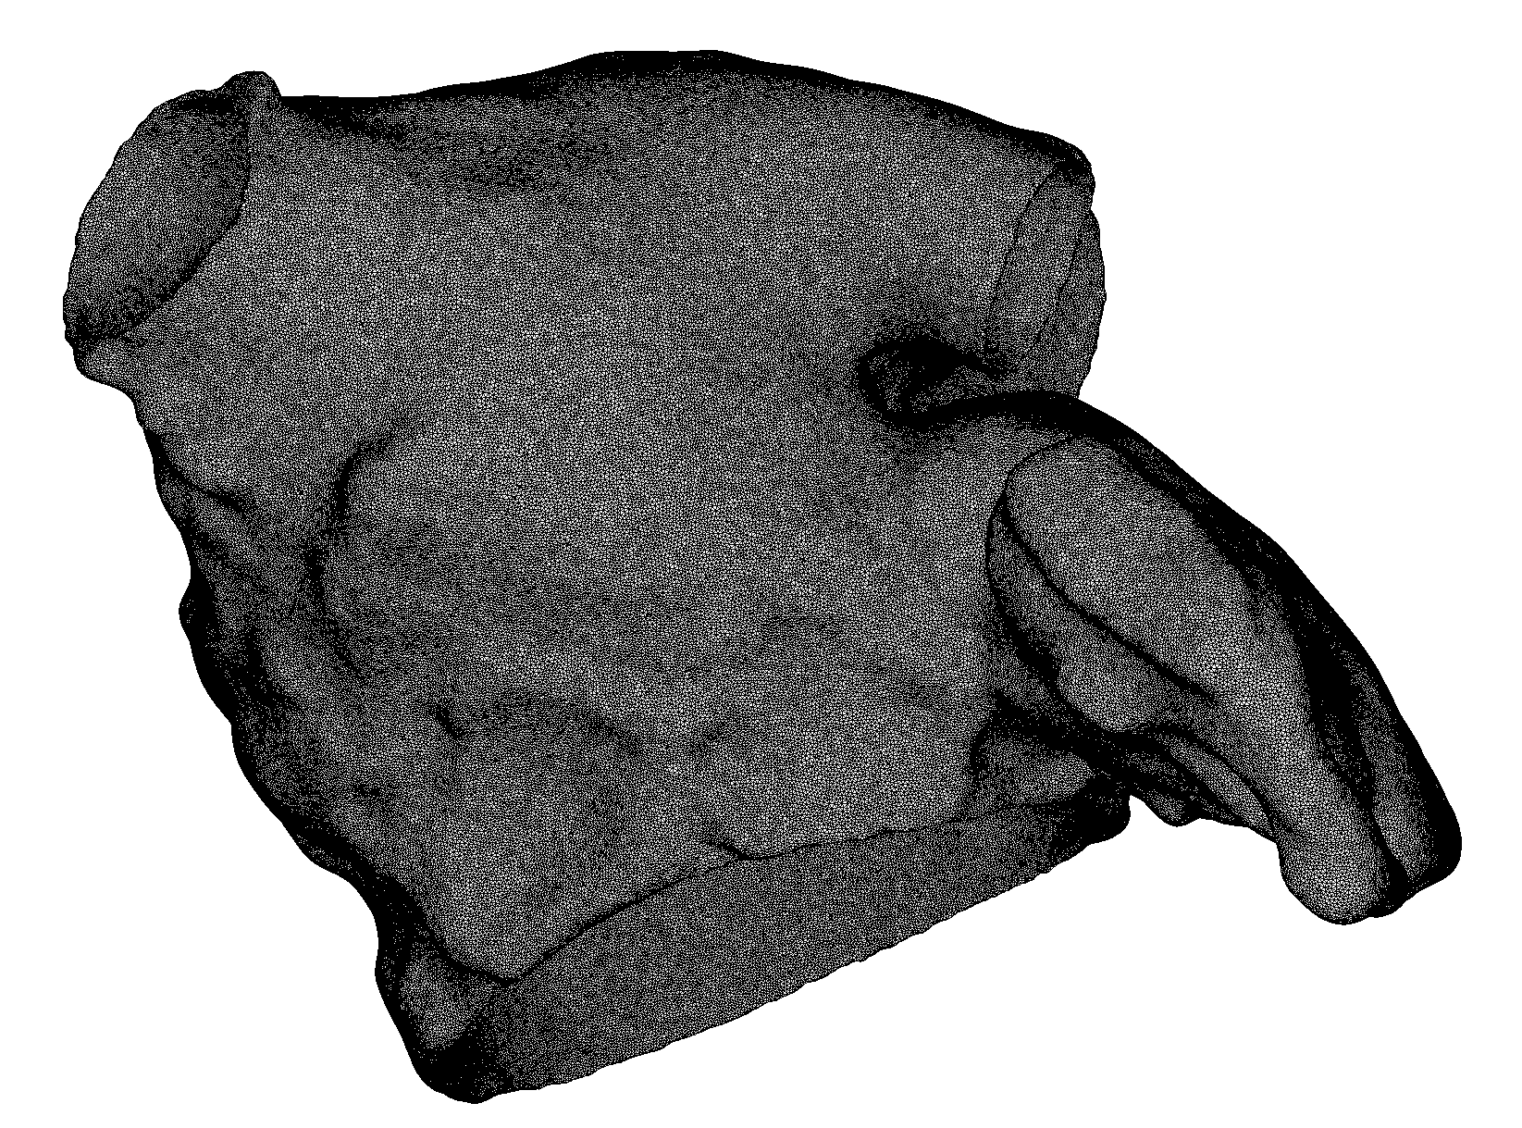
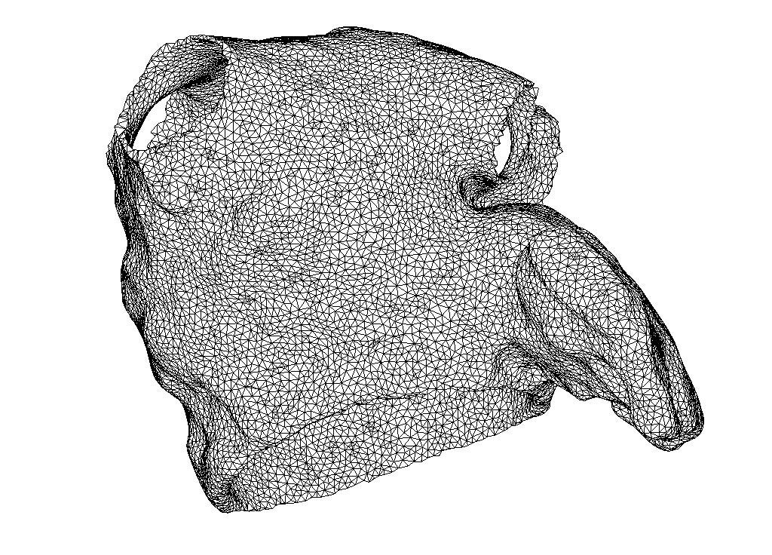
General procedures for mesh generation in solid mechanics
Examples (Left atrium)
Original mesh from open source (suitable for electrophysiology simulation)
Element edge length: 0.12 mm
# element: 121,207,799
# node: 21,868,400
Coarsened mesh (suitable for mechanical simulation)
Element edge length: 1 mm
# element: 92,590
# node: 28,808

Slide 10
Mesh convergence
Mesh convergence studies aim to determine the smallest mesh element size required to ensure that the results of finite element analysis are not affected by the size of the mesh.
Mesh refinement: increase element order or decrease element size.
General process:
Determine the quantities of interest from finite element simulations (e.g.
displacement, strain and stress).
Start with an initial mesh and continue to refine the mesh until the
values of the quantities converge satisfactorily.
Special cases:
Singularities.
Shear locking effect.
Volume locking effect.
Quantity of interest
Degree of freedom

Slide 11
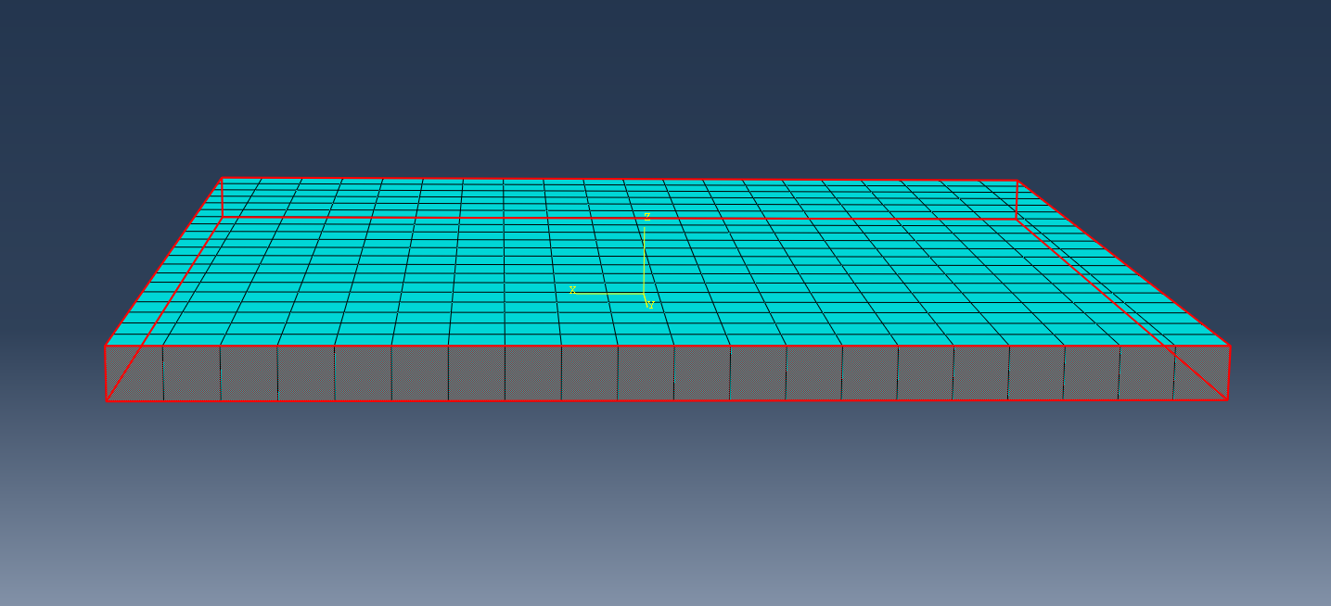

Mesh convergence
Example, 3-D square plate with side length 1mm and thickness 0.05mm.
Sides are fixed and a uniform pressure of 0.02 MPa is applied on the top surface.
Material, neo-Hookean
with C_10 = 50 MPa, D_1 = 0.9E-02 MPa⁻¹ .

Slide 12
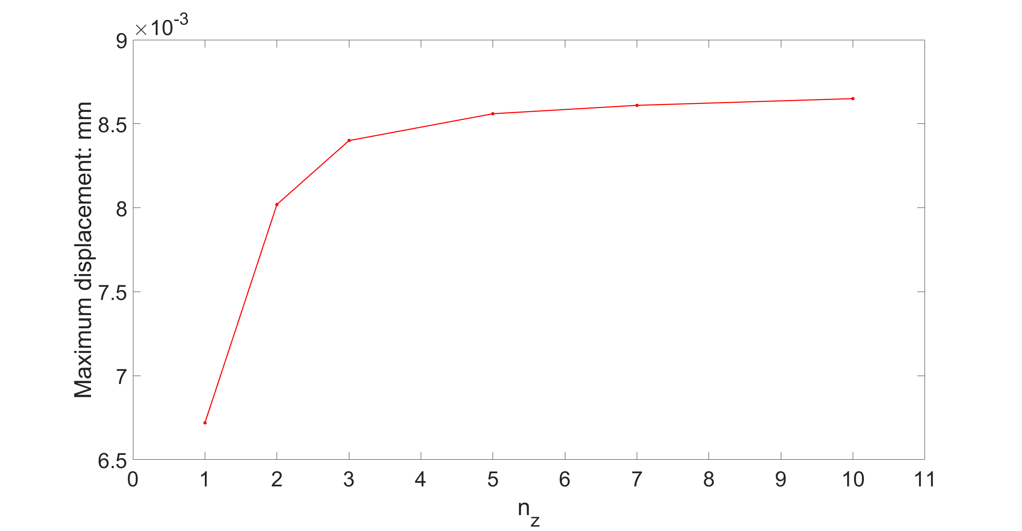
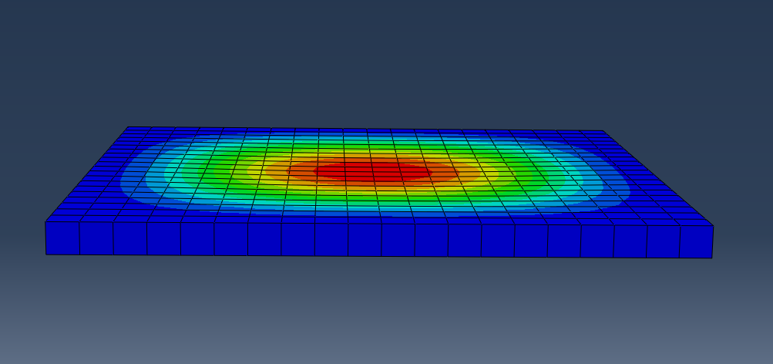
Mesh convergence
Simulations are ran in Abaqus Standard with linear 8-node hexahedron element.
dx=0.05 mm,
simulation time 2s
dx=0.01 mm,
simulation time 20s
dx=0.005 mm,
simulation time 214s

Slide 13
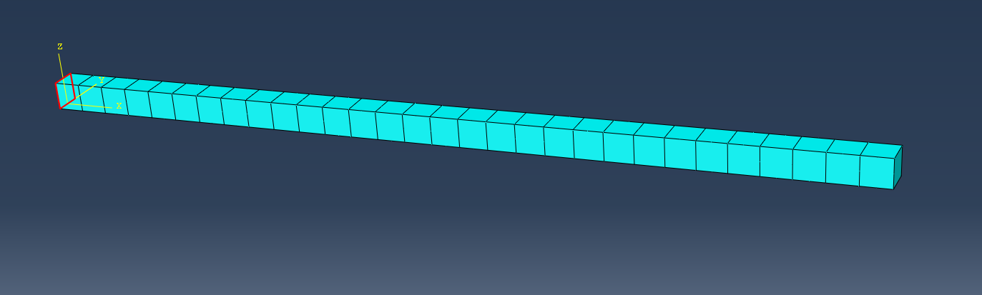
Mesh convergence
Example, 3-D beam, length L=3 mm and square cross section with side length a=0.1 mm.
Left side fixed and a uniform pressure p=0.001 MPa on the top surface
Neo-Hookean material, linear and quadratic hexahedron element.
Maximum deflection = p*a*L⁴/(8*E*I) where E Young’s modules and I moment of inertia
Maximum deflection = 0.466 mm in the current setting.

Slide 14
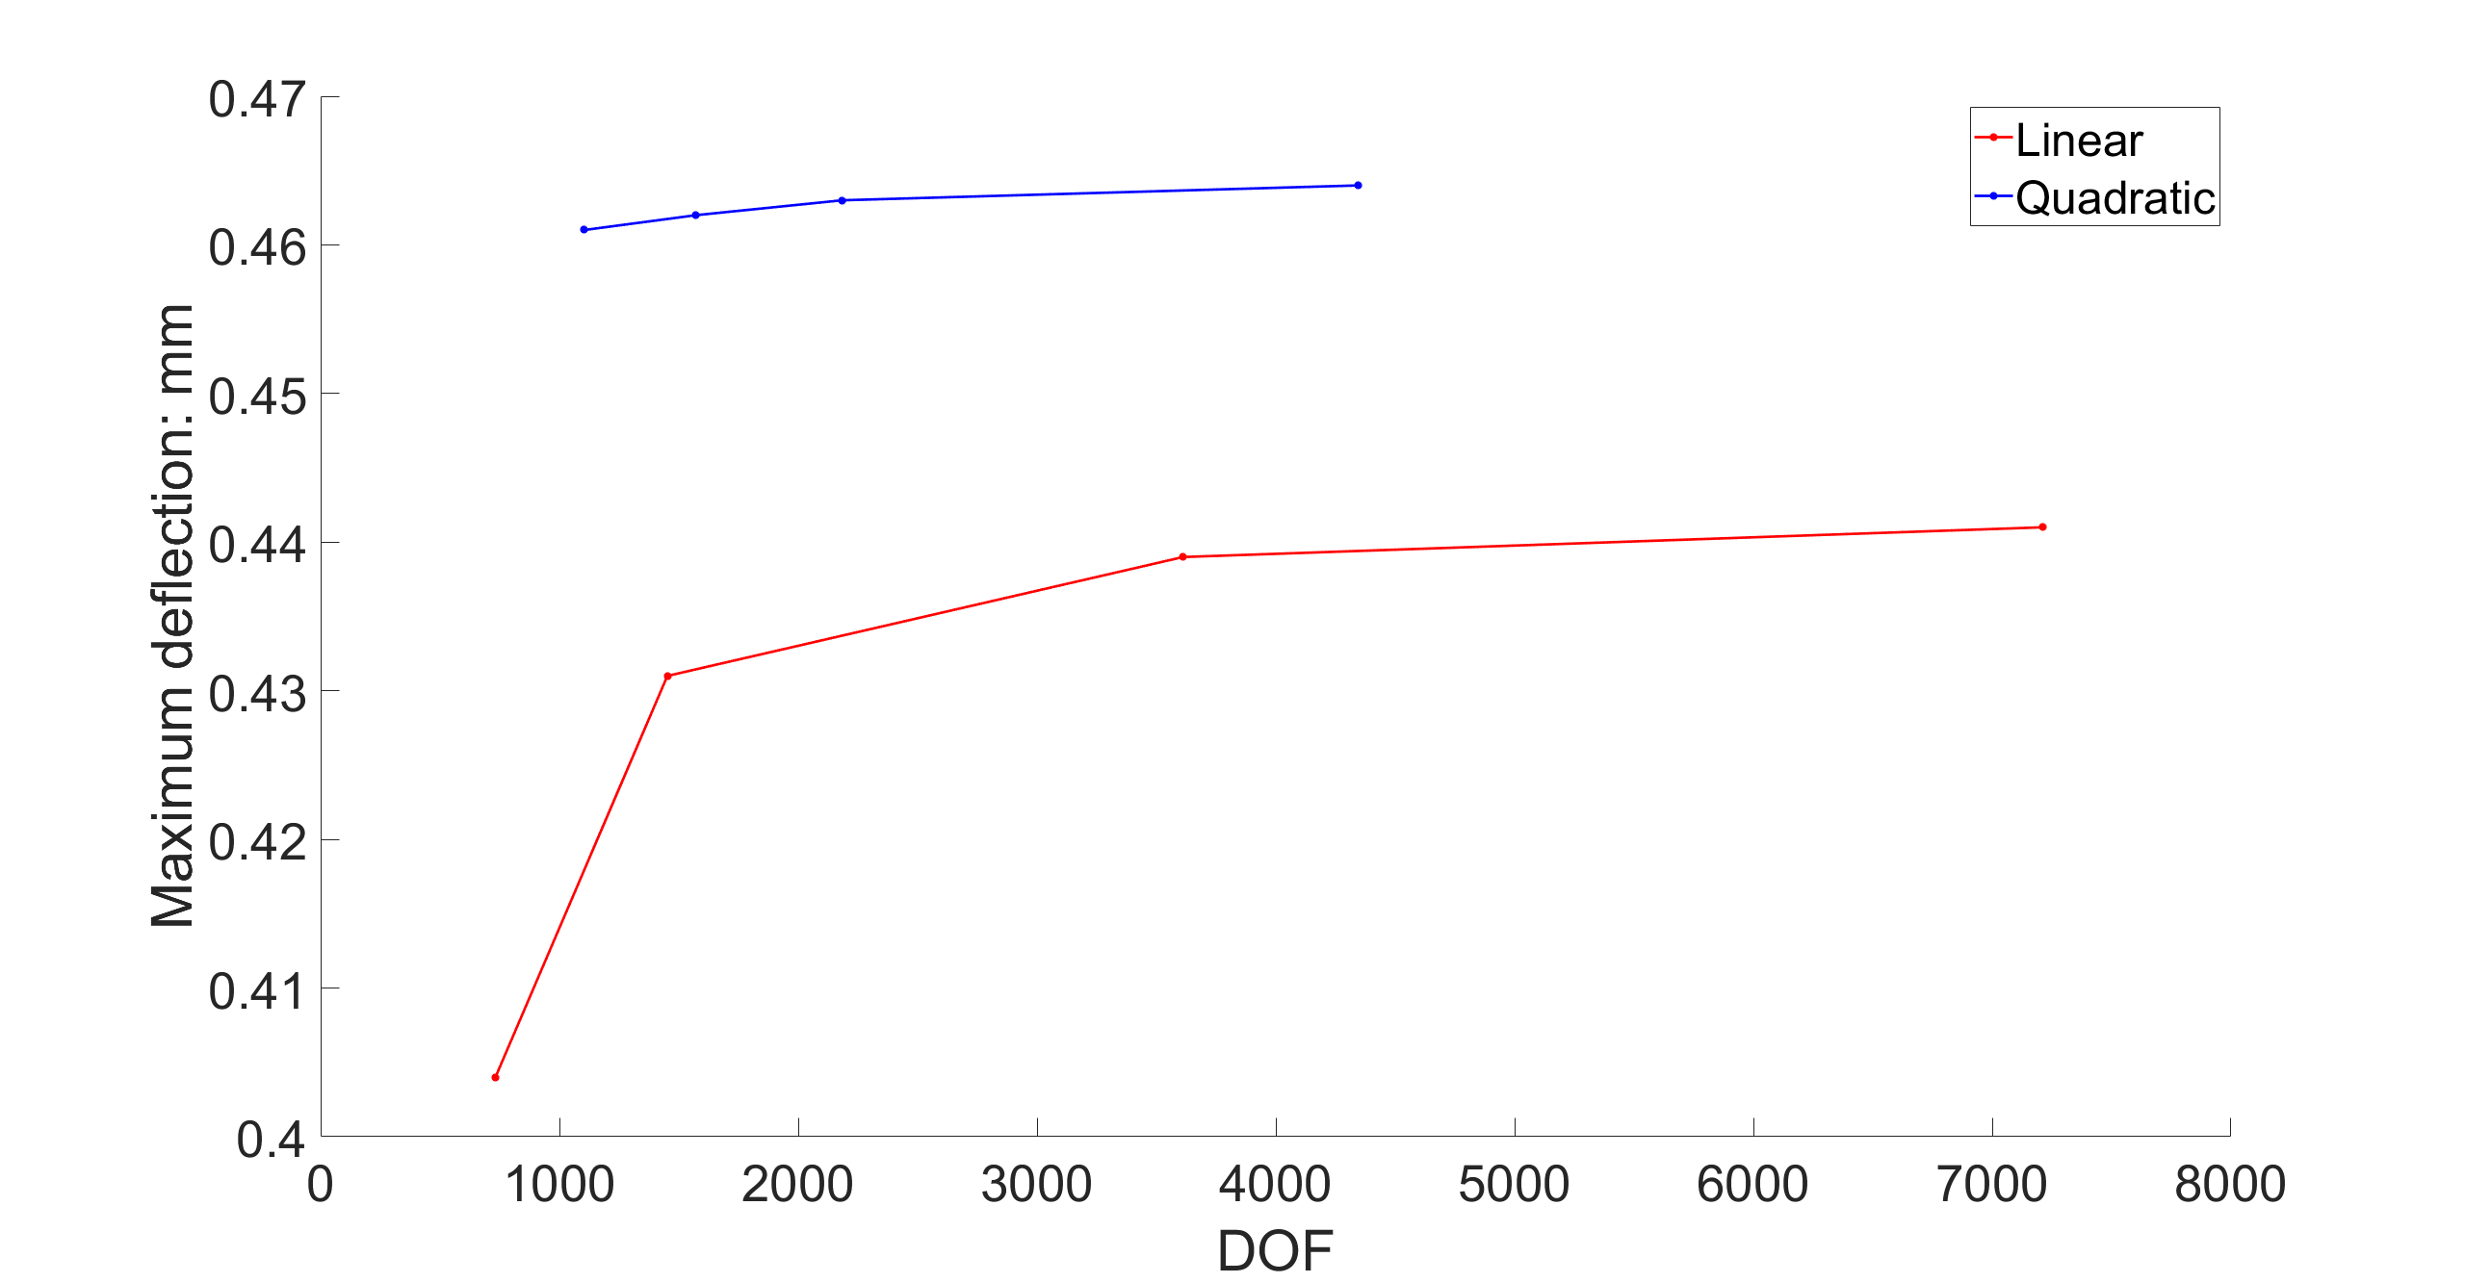
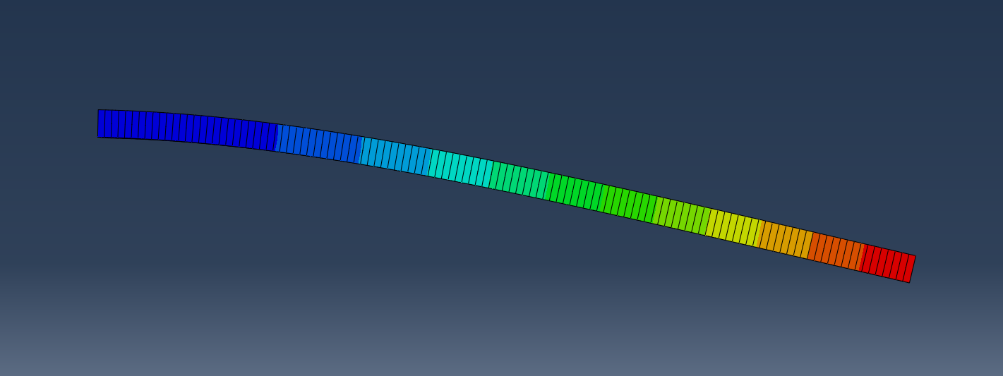
Mesh convergence
Shear locking effect

